Slide 1
History of Racism and Clinical Trials
Boston Team: Candace Feldman, MD, ScD; Jessica Williams, MD, MPH; Elmer Freeman (CCHERS), Kreager Taber, BA
Chicago Team: Rosalind Ramsey-Goldman, MD, DrPH, Patricia Canessa, PhD, Karen Mancera-Cuevas MS, MPH, CHES;
Holly Milaeger, MPH
Funding: This work was funded by the Department of Health and Human Services, Public Health Service, Office of Minority Health Grant #1 CPIMP171141-01-00 and #1 CPIMP18116801-00
Notes:
Comments: I had suggested to include an introductory paragraph to this section because the classification of “race” has an historical, cultural and demographic significance that is very unique to the United States. Race or ethnicity (a term rarely understood abroad) are perceived as barriers to engagement rather than facilitators of trusting relationships. Given the consideration of the significance of race to the US the rest of the slides accomplish its purpose. However, given the fact that African descendent demographics are more complex in Boston than in Chicago, where our selected group are likely to be African descendants that arrive during the Great Migration after the end of the Civil War. During our meetings in Boston, and conversations with the staff I noticed the presence of Haitian, Caribbean and transient or recently arrived immigrants, therefore our vision should be inclusive of them and the likelihood of utilization of this educational tool among more African diverse urban and suburban areas.

Slide 2
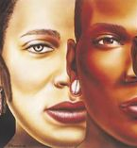
Defining “Race”
Merriam-Webster dictionary definition: “a category of humankind that shares certain distinctive physical traits”
However, a person’s race is often based on society and culture rather than physical traits also known as phenotypic traits
Example: “one-drop rule”
There are more genetic differences within a race than there are genetic differences between racial groups
There is a troubling legacy of discrimination against people of color throughout American and world history
This has been increasingly recognized and addressed throughout the last few decades through policies and cultural change
However, racism is still deeply embedded in our institutions and society
Merriam-Webster is updating its definition of “racism” to include structural racism as well as personally mediated racism
In this presentation, we will critically examine the history of racism in medical research so that we may progress towards full, consenting participation of people of color in research that advances scientific knowledge
www.merriam-webster.com/dictionary/race
Witherspoon DJ et al, Genetics. 2007 May; 176(1): 351–359.
Image: www.originalblackwoman.wordpress.com/2015/09/09/more-the-many-shades-of-black-beauty/
Notes:
Racial groups are very heterogeneous. Average African American descendant of slaves has 25% European ancestry.
Many Americans are in fact multiracial
Race is more of a social/cultural distinction in the United States, with significant historical context especially as pertaining to the 400 year oppression of slaves and their descendants
https://www.forbes.com/sites/janicegassam/2020/06/11/merriam-webster-is-changing-the-definition-of-racism-to-reflect-systemic-oppression/#76bcc047400f

Slide 3
The Gardener’s Tale: Allegory for Racism
TEDx Emory video entitled “Allegories on Race and Racism” by Dr. Camara Jones:
https://www.youtube.com/watch?v=GNhcY6fTyBM
Jones C. Levels of Racism: A Theoretic Framework and a Gardener’s Tale. AJPH 2000
Notes:
To activate link: Press control and click on link
If that doesn’t work, right-click and select “Open Link”
Light brown soil=resource-poor environment
Dark brown soil=resource-rich environment
Pink flowers represent racial minorities
Red flowers represent White people
White people flourish because they are provided with a resource-rich environment, while racial minorities struggle because they are provided with a resource-poor environment. The one who decides is the gardener, who represents the government.

Slide 4
Defining Racism
Jones C. Levels of Racism: A Theoretic Framework and a Gardener’s Tale. AJPH 2000
Notes:
Give examples when presenting this of SLE specific examples from focus groups
Institutionalized Racism: differential access to the goods, services, and opportunities of society by race
Personally-mediated racism: prejudice (differential assumptions about the abilities, motives, and intentions of others according to their race) and discrimination (differential actions towards others according to their race)
Internalized racism: acceptance by members of the stigmatized races of negative messages about their own abilities and intrinsic worth
Can describe how the gardeners tale relates to each of these: see slide 3
Personally mediated racism: when the gardener, disdaining the pink flowers because they look so poor and scraggly, plucks the pink blossoms off before they can even go to seed. Or when a seed from a pink flower has been blown into the rich soil, and she plucks it out before it can establish itself
Internalized racism: when a bee comes along to pollinate the pink flowers and the pink flowers say, “Stop! Don’t bring me any of that pink pollen—I prefer the red!” The pink flowers have internalized the belief that red is better than pink, because they look across at the other flower box and see the red flowers strong and flourishing.

Slide 5
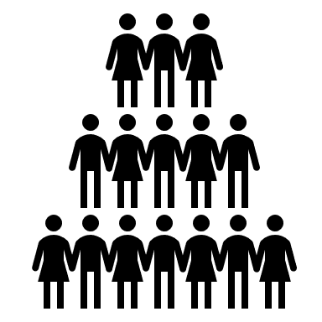
Does Racism Still Exist?
Among Black women with lupus, unfair treatment and discrimination is associated with more severe disease
Discrimination may lead to increased stress which can increase inflammation and disease damage
Black and Hispanic women with lupus who are pregnant have higher than expected rates of poor outcomes such as preterm birth
Likely related to decreased access to care, social determinants of health, and differential treatment by health care providers
Black and Hispanic patients presenting to the emergency department with pain are less likely to receive pain medications than White patients presenting with pain
Likely related to racial biases regarding pain tolerance and communication/language barriers
Chae DH et al, Am J Public Health. 2015 October; 105(10): 2099–2107.
Clowse ME et al, Arthritis Care Res (Hoboken). 2016 Oct;68(10):1567-72.
Lee P et al, Am J Emerg Med. 2019 Sep;37(9):1770-1777.
Notes:
When presenting: would discuss issues w/ access to care, differential treatment by medical providers, social determinants of health (access to healthy food, safe places to exercise)

Slide 6
The Black Lives Matter Movement and Healthcare
The Black Lives Matter Movement was begun by Alicia Garza, Patrisse Cullors, and Opal Tometi in response to the murder of 17-year-old Trayvon Martin by George Zimmerman
They created the #BlackLivesMatter hashtag in 2013 and Black Lives Matter has grown to represent a new civil rights movement
The recent murders of Breonna Taylor, Ahmaud Arbery, Tony McDade, George Floyd, Riah Milton, Dominique “Rem‘Mie“ Fells, and Elijah McClain have made many healthcare workers question their biases and examine what they can do to help dismantle institutionalized racism in the healthcare system
Medical students created the White Coats for Black Lives Organization in 2014
aims to “dismantle racism in medicine and promote the health, well-being, and self-determination of Black and Indigenous people, and other people of color.”
Racism is still deeply engrained in the healthcare system. With the Black Lives Matter Movement, information about racism and healthcare is reaching a wider audience.
Notes:
https://blacklivesmatter.com/
https://whitecoats4blacklives.org/

Slide 7
Racism and COVID-19
In Boston, Black residents account for 25% of the city’s population but approximately 37% of confirmed COVID-19 cases and 35% of deaths
In Chicago, Black residents account for 32% of the city’s population, 32.1% of confirmed COVID-19 cases, and 47.5% of deaths
This reflects national data: the CDC reports that non-Hispanic Blacks account for 13% of the US population, but they make up about 25% of COVID-19 deaths
According to the CDC, “Long-standing systemic health and social inequities have put some members of racial and ethnic minority groups at increased risk of getting COVID-19 or experiencing severe illness, regardless of age”
Notes:
Boston- https://www.boston.gov/departments/mayors-office/racial-data-boston-resident-covid-19-cases
National data: https://www.cdc.gov/nchs/nvss/vsrr/covid_weekly/index.htm#Race_Hispani
https://www.cdc.gov/coronavirus/2019-ncov/need-extra-precautions/racial-ethnic-minorities.htmlc
Map Chicago- https://www.chicago.gov/city/en/sites/covid-19/home/latest-data/2020-05-17.html

Slide 8
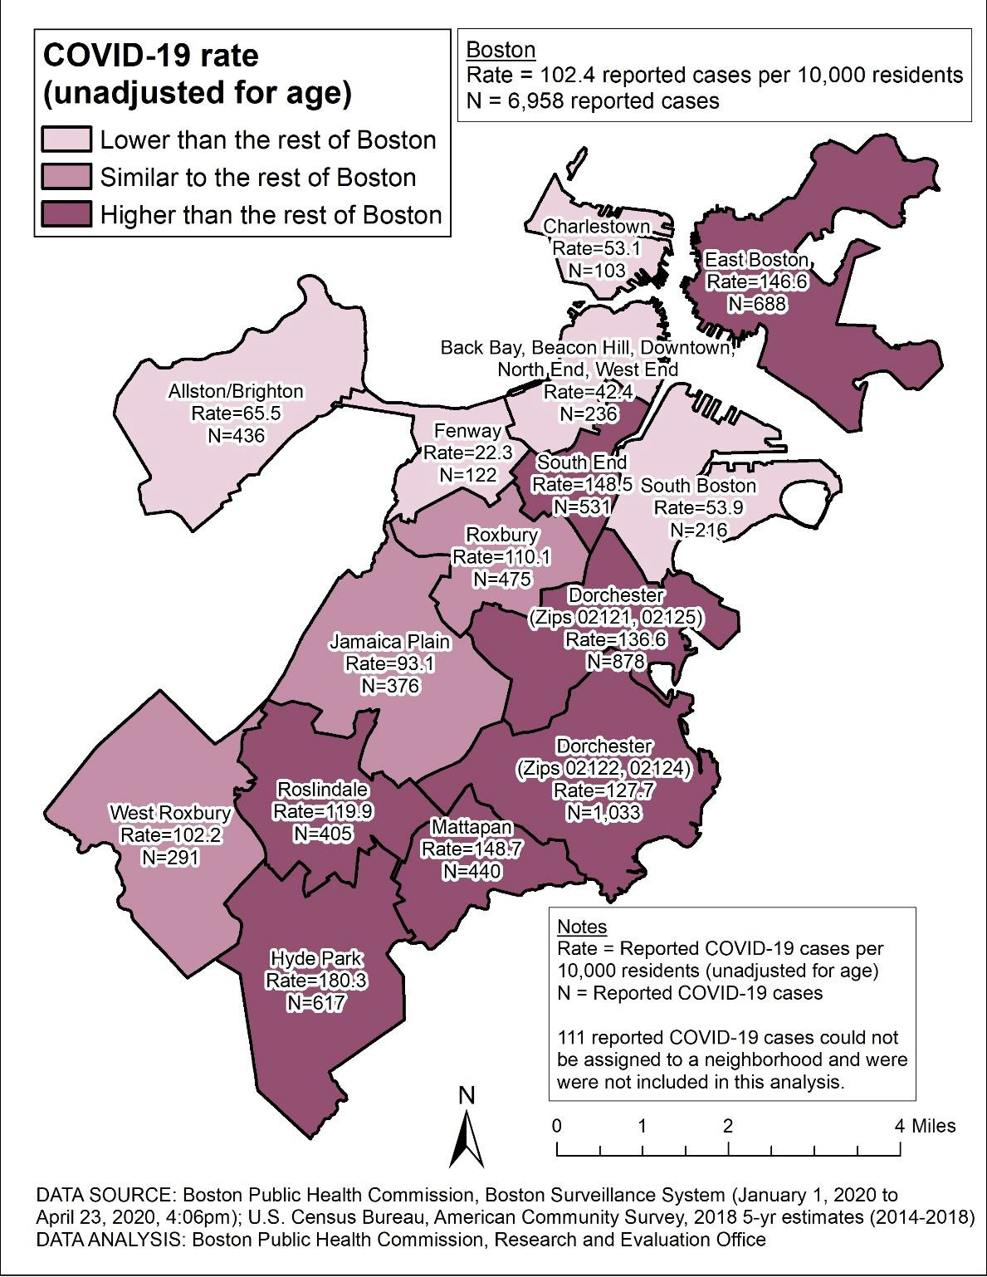
Cases of COVID-19 in Boston and Chicago Neighborhoods
Maps include data through April 23, 3030 (Boston) and July 13, 2020 (Chicago)
Darker colors=More COVID-19 Cases
Notes:
Boston as of April 23, 2020
Chicago through July 13th
Boston- https://www.boston.com/news/coronavirus/2020/04/25/boston-coronavirus-cases-neighborhood
Chicago- https://www.chicagotribune.com/coronavirus/ct-viz-covid-19-cases-by-zip-code-20200407-aikakoyycje4fbqvferzjffkg4-htmlstory.html

Slide 9
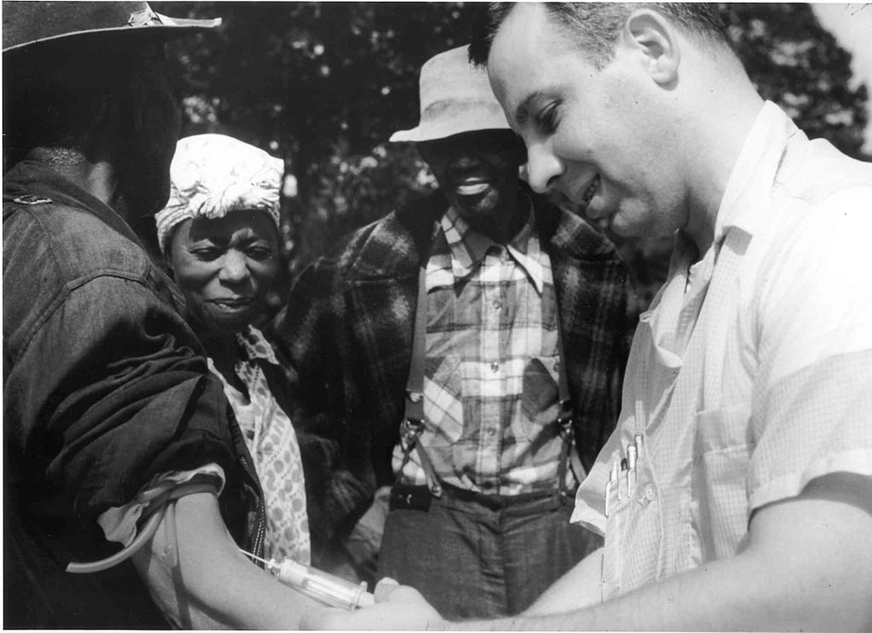
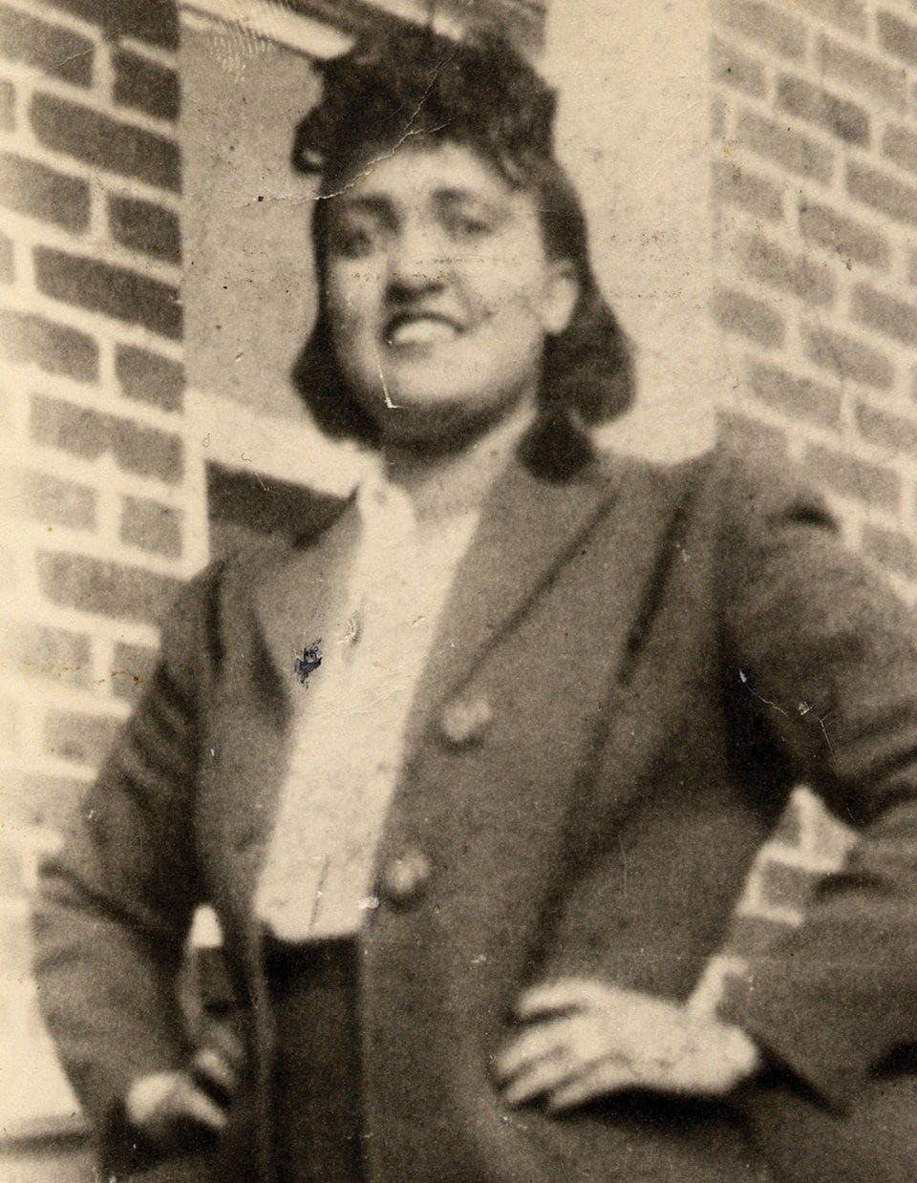
Historical Context of Racism in Medical Research in the U.S.
Racism is a process rather than a sequence of events, therefore the following examples provide only a small snapshot of how racist research projects in the U.S. have caused harm:
Tuskegee Syphilis Study
600 Black men followed over 40 years (1932-1972)
Goal of the study was to understand the natural course of syphilis
These men were not told that they had syphilis and were not treated, though treatment was available
Henrietta Lacks
31-year-old Black woman whose cervical cancer cells were removed in 1951 without her consent
Her cells were used to create the first immortal cell line for medical research
Neither she nor her family were compensated
Image: National Archives Atlanta, GA (U.S. government)
Image: www.washingtonpost.com
Notes:
When presenting: these are just examples of historical context of racism in medical research in US; emphasize that there are multiple instances
Other examples: J Marion Sims experimented on Black female slaves without anesthetic in order to perfect technique for GYN vesicovaginal fistula repair, forced sterilization of Black women aka “Mississippi appendectomy”
Emphasize the magnitude of racism impacting the African descendent population over the last three centuries. Present a perspective of racism as a process rather than isolated events and briefly identify structural and other forms of racism that intersected with misconceptions of research and people of color.

Slide 10
Clinical Trials Focus Groups: Thoughts on Race
“My friends always say “Don’t do it. Don’t forget your history...It haunts a lot of us…Any person of color.”
“A lot of the clinical trials, we would like to do them, but a lot of times, we don’t qualify… most of the time, with African American women, we don’t qualify for a lot of the studies unless you lie.”
“A lot of minorities, especially Black families, ‘cause we don’t go to the hospital, we wait until the very last minute, so when we do go to the hospital, we die. Then you’ll have people say, “Don’t go to the hospital. They kill you...”

Slide 11
Clinical Trials Focus Groups: Thoughts on Race
“For me that [the race of the researcher] doesn’t matter. I just want to know that the person is truthful…if the person seems truthful and open and whatever, that’s fine.”
“It’s needed. It’s needed. It’s needed. Because every time you look around, they’re always doing cancer research. Lupus is just as prevalent out there as cancer. It’s mainly in our community…the Black community.”
“It’s a catch 22. We’re more predominantly affected. If we don’t participate in trials that benefit us, even more of us will be affected.”
Notes:
Themes: historical injustices leading to fear of participating, exclusion criteria disproportionately exclude minorities, importance of trust-building with research team, clinical trial participation is needed to help the greater lupus community (especially patients of color) by advancing treatment of lupus

Slide 12
Safeguards to Prevent Racism in Clinical Trials
1974 National Research Act:
Voluntary informed consent
Institutional Review Boards
Federal oversight
Presidential Commission for the Study of Bioethical Issues
https://www.cdc.gov/tuskegee/after.htm
https://bioethicsarchive.georgetown.edu/pcsbi/index.html
Notes:
Informed of risks and benefits before participating, can withdraw at any time
There is oversight both at the institutional level (IRB) and federal government level

Slide 13
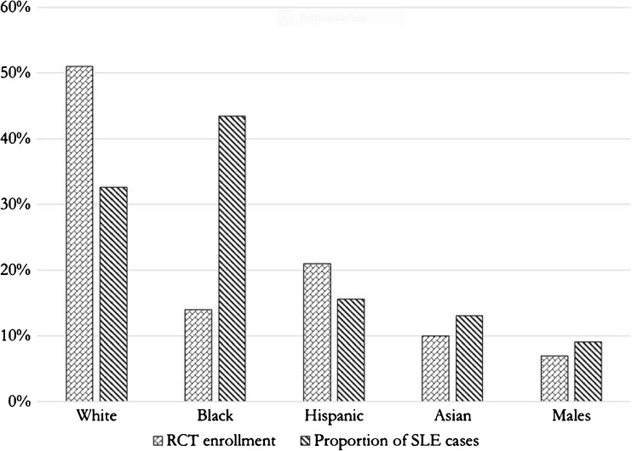
Non-White People are Under-Represented in Clinical Trials
43% of people with lupus are Black, but only 14% of lupus clinical trial participants are Black
Why is this the case?
Mistrust of physicians and researchers
Lack of authentic academic-community partnerships
Strict inclusion criteria
51%
43%
33%
14%
Falasinnu T et al, Curr Rheumatol Rep. 2018 Mar 17;20(4):20.
Lima K et al, Arthritis Care Res (Hoboken). 2019 Jul 26.
Notes:
Would emphasize that Asian patients and males are also underrepresented

Slide 14
This is Also True in Boston…
Dana Farber Cancer Institute:
2 in every 5 White residents receive their cancer care there compared to 1 in 5 Black residents
Boston Medical Center, where Black Bostonians are more than three times as likely to get care, listed 7 clinical trials for breast cancer and 6 for lung cancer in 2017 compared to 63 for breast cancer and 45 for lung cancer at the Dana-Farber
Notes:
This can be a placeholder slide for other cities to input their own relevant info

Slide 15
Why is it Important to Have Racial Diversity in Clinical Trials?
To study new interventions across all populations that they will be used to treat
If differences are found by race/ethnicity, the reason why must be investigated so that EVERYONE benefits
Certain conditions, such as lupus, are more common in people of color. We want to make sure that the people who are most affected by a disease are the ones benefiting from clinical trials, in order to get patients more effective treatments more quickly
Unequal enrollment in clinical trials perpetuates systemic racism in healthcare
Notes:
This is fundamentally about fairness. We want to make sure new drugs/interventions work in all patients, regardless of race, and if they don’t seem to work the same then we need to find out why. This will require a large number of minority patients to enroll in clinical trials (oversampling)
It is fundamentally unfair for a population with a greater burden of disease to be denied a new treatment because of their race, when their race was in fact not well represented in the initial studies (example: belimumab)

Slide 16
Questions? Thank You!

Slide 17
Additional Reading
Racial health disparities
www.cdc.gov/minorityhealth/index.html
Institute of Medicine: http://www.nationalacademies.org/hmd/~/media/Files/Report%20Files/2003/Unequal-Treatment-Confronting-Racial-and-Ethnic-Disparities-in-Health-Care/PatientversionFINAL.pdf
Tuskegee Syphilis Study
Bad Blood: The Tuskegee Syphilis Experiment, book by James H. Jones
www.cdc/gov/tuskegee
Henrietta Lacks
The Immortal Life of Henrietta Lacks, book by Rebecca Skloot

Slide 18
Funding and Acknowledgements
Funding: This work was funded by the Department of Health and Human Services, Public Health Service, Office of Minority Health Grant #1 CPIMP171141-01-00 and #1 CPIMP18116801-00
Boston Team: Candace Feldman, MD, ScD; Jessica Williams, MD, MPH; Elmer Freeman (CCHERS), Kreager Taber, BA
Chicago Team: Rosalind Ramsey-Goldman, MD, DrPH, Patricia Canessa, PhD, Karen Mancera-Cuevas MS, MPH, CHES;
Holly Milaeger, MPH

